Slide 1
5G: The Real Long Term Evolution
Technology Summary based on Architecture work Group White Paper
October 2016

Slide 2
Agenda
5G Eco-system
5G Design Objectives
5G Overall Architecture
5G Network Softwarization
5G Softwarization & Programmability
5G Network Slicing
5G Control, mngt and orchestration
5G Impact on Physical network and computing
5G Multi Service Control and Management
5G Multi-Domain Architecture
5G Network Security Considerations
5G Standardization
5G Logical Architecture
Considered RAN Logical Architecture
Mobile Edge Computing
Orchestration and Network Management
5G Physical Architecture
Physical deployment Map
C-RAN and frontHaul/BackHaul
5G Softwarization
Software network technologies in 5G overall architecture
Softwarization in radio access networks and mobile network edge
Softwarization in core networks & transport networks
Programmability and Orchestration
Flexible network function orchestration
Service orchestration

Slide 3
Introduction
The European Union funded 5G Public Private Partnership (5GPPP) is an important initiative where public and private sectors in Europe work together to develop 5G
The 5G networks will be built around people and things and will natively meet the requirements of three groups of use cases:
Massive broadband (xMBB) that delivers gigabytes of bandwidth on demand
Massive machine-type communication (mMTC) that connects billions of sensors and machines
Critical machine-type communication (uMTC) that allows immediate feedback with high reliability and enables for example remote control over robots and autonomous driving.
5G Technology to provide low-latency, ultra-reliability, massive scalability and very high data rate to support these use cases

Slide 4
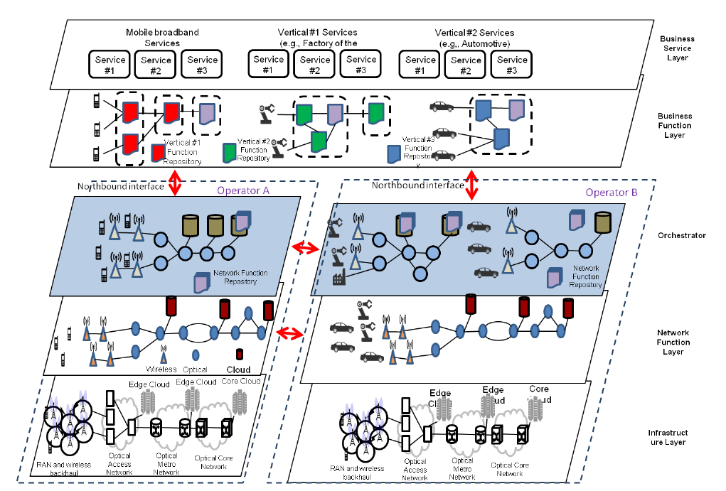
5G Eco-system
Key requirements
Support vertical Markets (Slicing)
Accelerate service delivery
Massive Network, computing & storage integration
Flexibility/Programability
Multi-tenancy and Multi-service
Orchestration and Autonomic management
Differentiated network slice QoS (latency, reliability, throughput, …)
New trust, user privacy and security model

Slide 5
5G Design Objectives
Operate in wide Spectrum range with diverse range of Characteristics
Efficient transmission and data processing moving functional closer to the edge (Mobile Edge Computing)
SDN and NFV Paradigm and Approached to be followed
Ubiquitous separation of user and control plane
Re-definition of boundaries between network domains and wide range/ flexible physical deployment architecture depending on slide and use cases
Different air interface variance
Interworking with evolution of LTE
Advanced antenna technos: multi-antenna, Massive MIMO, beam-forming capabilities
Multi-connectivity across all mobile technologies to achieve QoS
Network controlled Device to Device communications
Enhanced and diverse backhauling approaches as well as even tighter fixed-mobile convergence/interworking
Network slicing to allow guaranteed and differentiated QoS between slices running on the same physical infrastructure
End-to-end Resource, Infrastructure and Service Orchestration
New advanced autonomic network management making use of machine learning / cognitive approaches
Multi-tenancy environment

Slide 6
5G Overall Architecture
5G networks are conceived as extremely flexible and highly programmable E2E connect-and-compute infrastructures that are application- and service-aware, as well as time-, location- and context-aware. They represent:
an evolution in terms of capacity, performance and spectrum access in radio network segments; and
an evolution of native flexibility and programmability conversion in all non-radio 5G network segments: Fronthaul and Backhaul Networks, Access Networks, Aggregation Networks, Core Networks, Mobile Edge Networks, Software Networks, Software-Defined Cloud Networks, Satellite Networks and IoT Networks.
5G Architecture enables new business opportunity and leverages future proof approaches
Implementing network slicing in cost efficient way
Addressing both end user and operational services, (iii) supporting softwarization natively
integrating communication and computation
integrating heterogeneous technologies (incl. fixed and wireless technologies)

Slide 7
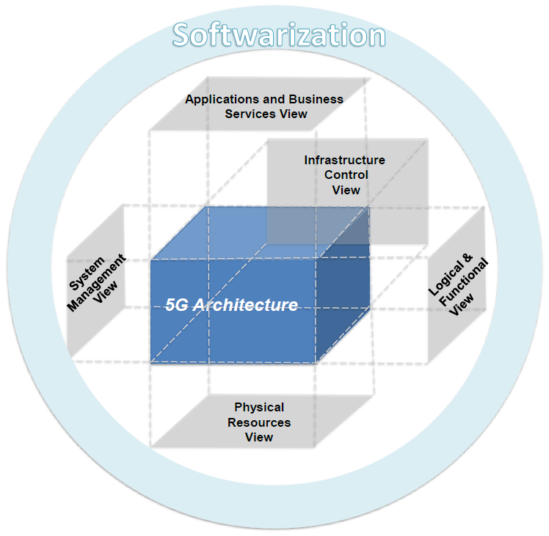
5G Network Softwarization
Shift in networking paradigms: a transition from today’s “network of entities” to a “network of (virtual) functions”
functions should be able to be composed on an “on-demand”, “on-the-fly” basis
advantages emerge in the areas of management, control of systems and resources
The network softwarization and programmability is one of the basis for the 5G architecture design and impacts all identified views

Slide 8
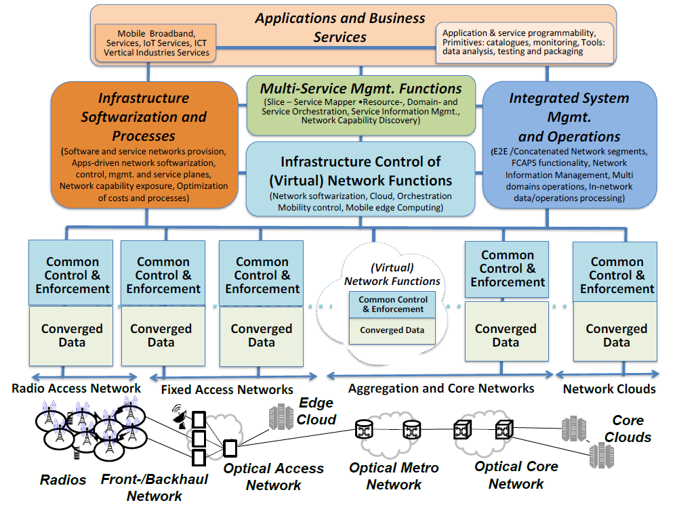
5G Softwarization & Programmability (1)
Separate Planes but inter-dependent. Interworking between planes realized though reference points and interfaces
5G Converged Data Plane functions are distributed to the edges of a common core network, resulting in creating a distributed flat network
The control plane functions direct the user traffic to be served agnostically to the access networks to which it is attached.
Notes:
5G Network Segments: Radio Networks, Fronthaul & Backhaul Networks, Aggregation and Core Networks, Network Clouds, Mobile Network (i.e. a combination of network segments where the last link is wireless - a radio network) and enabling technologies like Mobile Edge Networks, Service/Software Networks, Software-Defined Cloud Networks, Satellite Networks, IoT Networks.

Slide 9
5G Softwarization & Programmability (2)
Application and Business Service Plane – Defines and implements the business processes of the services along specific value chains. A service in the 5G context is a piece of software that performs one or more functions, provides one or more APIs to applications or other services of the same or different planes to make usage of those functions, and returns one or more results.
Multi-Service Management Plane – The functions and interfaces in this plane are used to set up and manage groups of network instances and/or nodes. More specifically, the setup consists of creating/installing/arranging NFs and interfaces according to the available physical and virtual resources. It also comprises the set of functions associated with the network operations, such as fault management, performance management and configuration management. It further includes Slice –Service Mapper functions, Resources, Domain and Service Orchestration functions, Service Information Management functions and Network Capability Discovery functions. In current mobile networks, this role is often performed by the Operations Support System (OSS).

Slide 10
5G Softwarization & Programmability (3)
Integrated Network Management & Operations Plane – Enables the creation, operation, and control of dedicated management functions operating on top of a 5G E2E infrastructure; and the collection of resources required for managing the overall operation of individual network devices. It further includes E2E Network segments management, FCAPS functionality, Monitoring operations, Network Information Management, In-network data and operations processing and Multi domains management operations
Infrastructure Softwarization Plane – Enables the provisioning and operation of software and service networks. It facilitates the operation of end-to-end heterogeneous networking and distributed cloud platforms, including physical and logical resources and devices. It includes software for designing, implementing, deploying, managing and maintaining network equipment, network components and/or network services by programming.
Infrastructure Control Plane - The collection of functions responsible for controlling one or more network devices. Control Plane instructs network devices, network elements, and network functions with respect to processing elementary data units (packets, frames, symbols, bits, etc.) of the user/data/forwarding plane. The control of (virtual) network functions include Control of Network Softwarization functions, Control of Orchestration functions, Control of Mobility control functions, Cloud Control functions, Mobile Edge Computing Control functions and adaptors to different enforcement functions.
Forwarding Plane / Data Plane - The collection of resources across all network devices responsible for forwarding traffic.

Slide 11
5G Network Slicing
network slicing is also an important part of the overall 5G architecture that addresses the deployment of multiple logical end-to-end networks as independent business operations on a common physical infrastructure
a “5G slice” could be composed of a collection of 5G network functions (NF) and specific radio access technology (RAT) settings that are combined together for a specific use case and/or business model
network slices must fulfill a set of requirements such as the need for sharing and efficiently reusing resources (including radio spectrum, infrastructure, and transport network); differentiation of traffic per slice; visibility of slices; protection mechanisms among slices (a.k.a. slice isolation); and support for slice-specific management

Slide 12
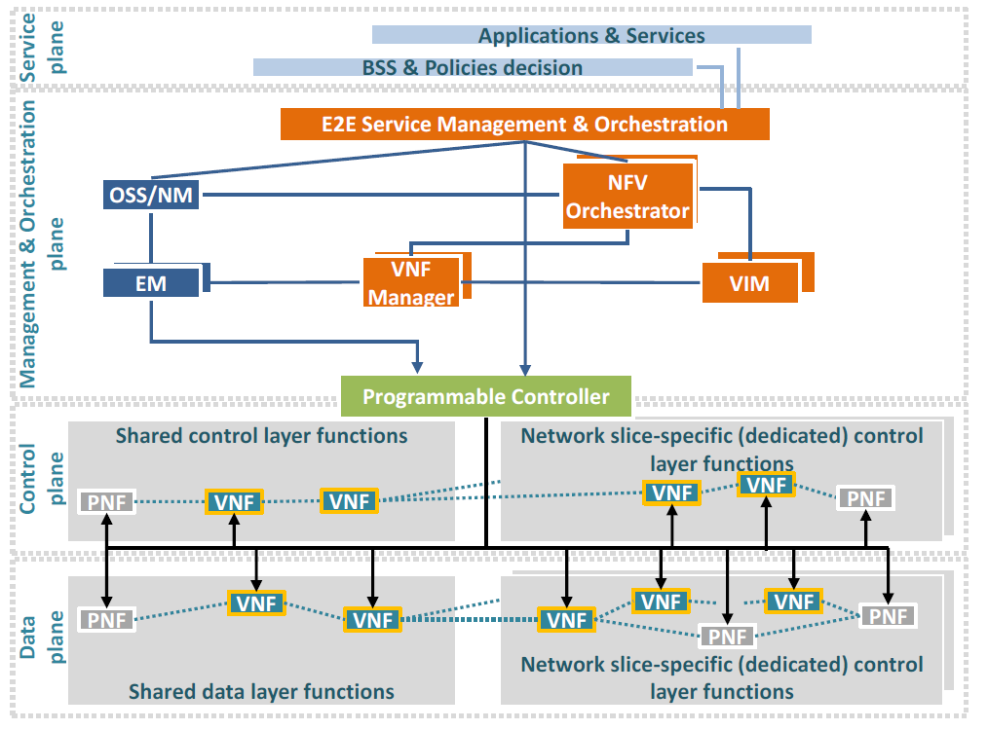
5G Control, mngt and orchestration
The separation of control and user plane, as introduced through software-defined networking (SDN)
Beside the radio access and core network, the transport network will play a key role in 5G (unique packet-based network )
This unified data and control plane interconnects distributed 5G radio access and core network functions, hosted on in-network cloud infrastructure
The 5G transport network will consist of integrated optical and wireless network infrastructure

Slide 13
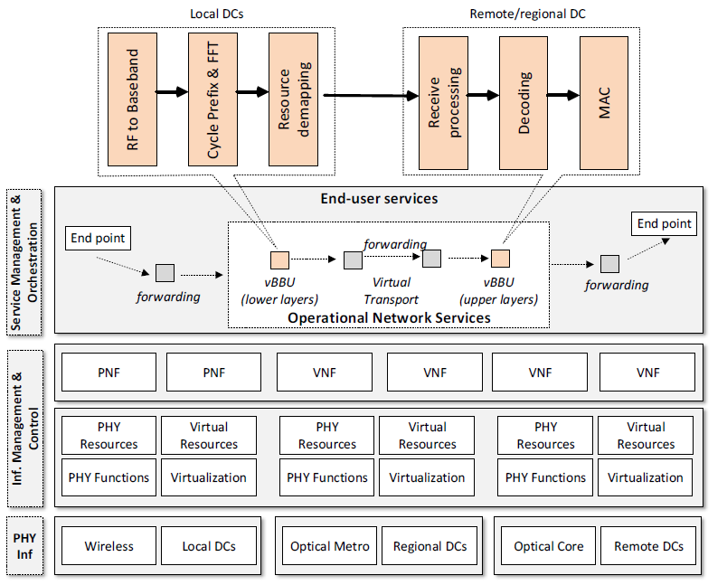
5G Impact on Physical network and computing
Traditional wireless macro-cell networks need to be transformed into architectures comprising large numbers of small cells complemented with macro cells for ubiquitous coverage: Cloud Radio Access Networks (C-RANs), with the option of flexible processing splits
Integration of Network, Compute and Storage Capabilities: C-RAN virtualized functions can be hosted either by micro-Data Centers (DCs) - referred to as Mobile Edge Computing (MEC) - or at remote regional and central large-scale
5G vision involves the adoption and integration of specific technical approaches supporting this paradigm, such as SDN and NFV. In SDN, the control plane is decoupled from the data plane and is managed by a logically centralized controller that has a holistic view of the network.
NFV enables the execution of software-based network functions on commodity hardware (general-purpose servers) by leveraging software virtualization techniques
Using these technology solutions, operational and business models such as multi-tenancy can be supported through network slicing and virtualization.

Slide 14
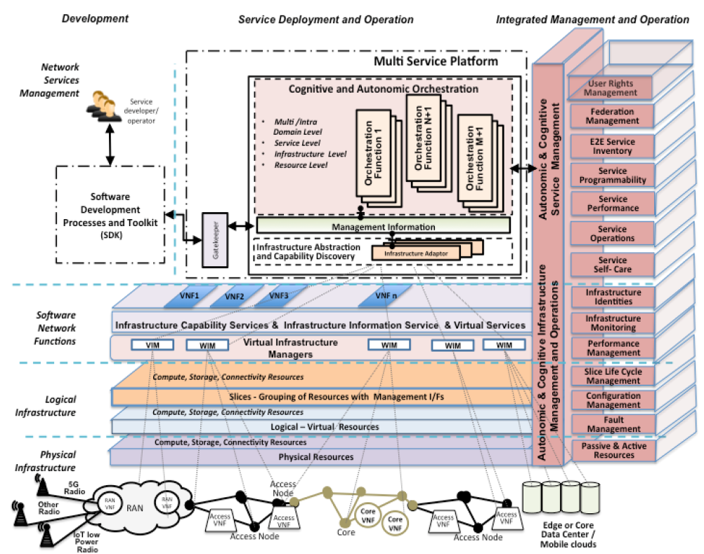
5G Multi Service Control and Management
increase the flexibility and programmability of 5G networks with a novel Service Development Kit, a novel, modular Service Platform and Service Orchestrator, and a novel Integrated Infrastructure Management
The Multi-Service Management plane is responsible for the creation, operation, and control of multiple dedicated communication network services running on top of a common infrastructure.
Application and Business Services plane that maintains 5G application-related functions, organized in Repositories, and DevOps tools necessary for the creation and deployment of services. Functionality for this plane includes DevOps functionality: Catalogues, Monitoring data analysis tools, testing tools, Packaging tools, Editors and primitives for Application & Service programmability

Slide 15
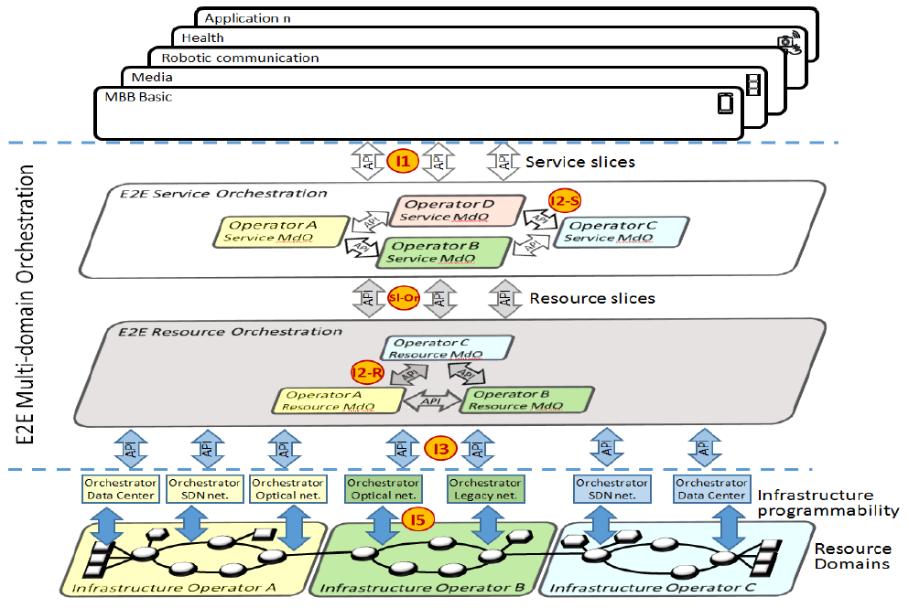
5G Multi-Domain Architecture
Multi-domain orchestration refers to the automated management of services and resources in multi-technology environments (multiple domains involving different cloud and networking technologies) and multi-operator environments (multiple administrative domains) which includes operation across legal operational boundaries
A Multi-domain Orchestrator (MdO) coordinates resource and/or service orchestration at multi-domain level, where multi-domain may refer to multi-technology or multi-operator
A Multi-domain Orchestrator (MdO) coordinates resource and/or service orchestration at multi-domain level, where multi-domain may refer to multi-technology or multi-operator

Slide 16
Network Security Considerations
TBC

Slide 17
5G Standardization
5GPPP: research activity
3GPP: 3GPP SA5 for Network management
ITU-T: Integration Network Management
ETSI: Reference of NFV
IETF: Specific IP Services/Chaining focus
ONF: Transport SDN/OpenFlow
BBF: Broadband Forum: Fixed networking
OneM2F: Machine to Machine / IoT aspects
MEF: Backhauling / Ethernet / SDN
TMF: Information and Integration Models

Slide 18
5G Logical Architecture

Slide 19
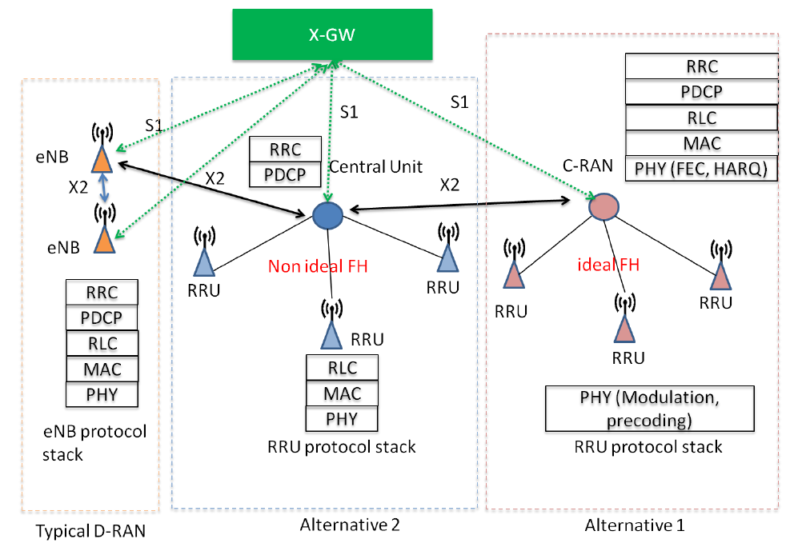
Considered RAN Logical Architecture
A key factor in determining the degree of centralization of RAN related functions is the type of backhaul or fronthaul available
logical interface between core network and radio access network, a typical baseline assumption applied in multiple 5G PPP projects is to consider an evolution of existing interfaces, such as the S1 interface in the EPS
State of the art: function split within PHY layer (e.g. based on CPRI or OBSAI interface). A classical solution in the context of C-RAN
Investigated alternative 1: Function split between PHY and MAC (see Figure 4-1). If fiber fronthaul is available and a high degree of centralization is desired
Investigated alternative 2: Function split between synchronous and asynchronous functions (e.g. RLC and PDCP) ([4-7], [4-9], [4-10]). If fiber fronthaul is not available (see Figure 4-1), hence low latency connectivity between centralized processing and RRU cannot be guaranteed,

Slide 20
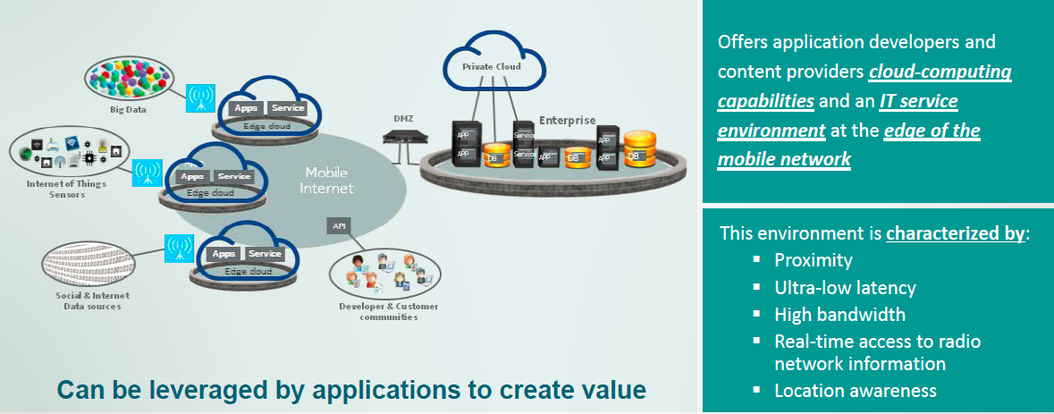
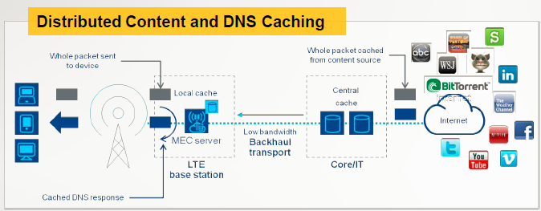
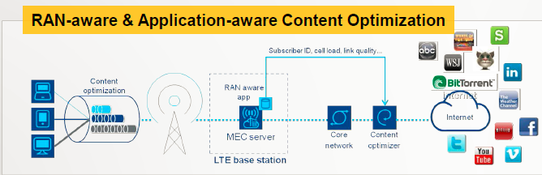
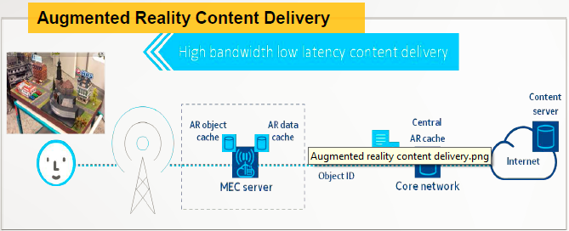
Mobile Edge Computing

Slide 21
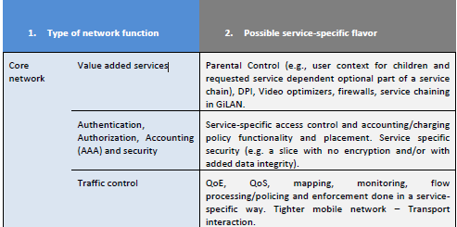
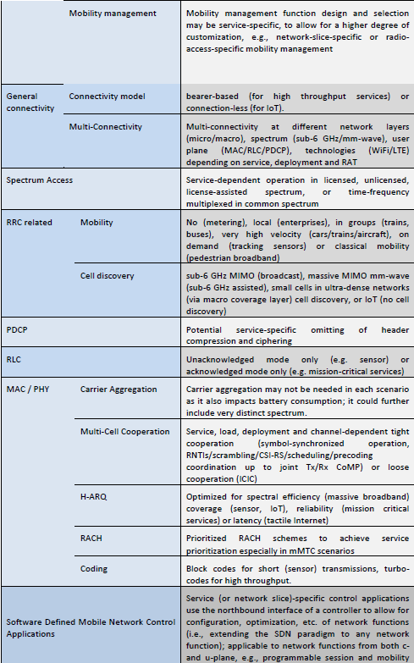

Considered Softwarized Network Functions
These are the considered network functions which could be tailored for specific services needs
Softwarization being the enable to provide the service specific behavior
Whether slicing on re-usable network functions is used or whether slice specific network functions are created
Softwarizatrion can be applicable to VNF or PNF

Slide 22
Orchestration and Network Management (1)
The role of the network management functions/orchestrator is to build complex network functions and services from less complex/primitive network functions. In this process, the orchestrator has to consider service specific requirements, e.g. latency, physical locations of specialized hardware, etc. This is done through the entire lifecycle of a function/service, i.e. deployment, operation, monitoring and termination. In addition, it analyzes the network situations in real time, diagnoses and predicts existing or emerging network issues, and determines and coordinates reactive or proactive actions to resolve issues.
Service orchestration - The prime goal is to adapt a service, typically composed of various types of functions, to the current system and load situations
Scaling up or out individual functions; restructuring a service graph
Modifying the placement of functions inside an actual network
Reroute traffic to or between different instances of such functions
Adjudicate resources between competing services
Lifecycle management of individual functions
Umbrella functions for e2e service/network slice management and cross-tenant orchestration (Inter-slice Orchestration, Umbrella and Service Management)

Slide 23
Orchestration and Network Management (2)
Service- and network function-specific orchestration algorithms
Since personalized treatment of services and even functions is assumed for 5G systems, it is necessary for an orchestration function to offer the appropriate means to achieve this (e.g., let a service provide its own placement algorithm to be executed in a secure fashion by the orchestration platform).
Resource orchestration
Orchestration of resources (i.e. connectivity, compute, and storage resources) across multiple network functions in the same domain or across multi-domains
Implementation of Network & Service management
The ability to reroute traffic between services and network functions is an important part of new 5G management functionality
The same is also true for autonomic capabilities like monitoring, optimization, configuration, fault resolution, and SLA operations
An orchestration platform hence has to interwork with the new 5G Management and Operation functions, and also provide convenient interfaces and interoperability with an existing, legacy network and service management system.
Uniform management enablers
In general, an orchestration platform could generalize over network management and service management, implementing them itself or providing access to and interfaces with such subsystems.

Slide 24
Physical Architecture

Slide 25
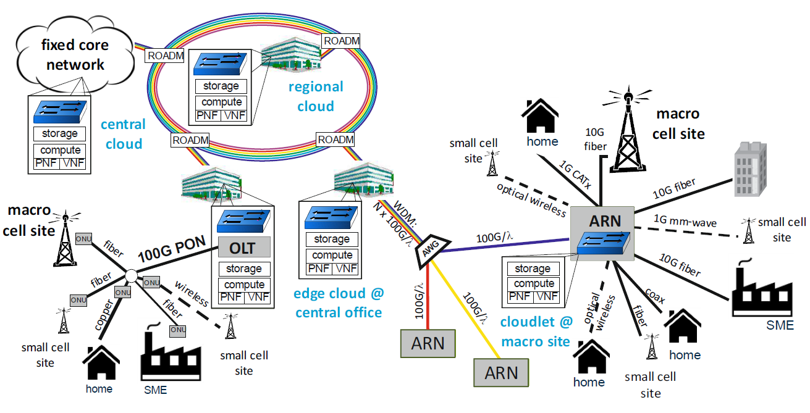
Physical Architecture
Most resources will be VNFs some that can not as too coupled to HW for achieved QoS will be clearly identified
A central cloud node lives in a centrally located data center. Such a center hosts a large collection of processing, storage, networking, and other fundamental computing resources. Typically, only a few central cloud nodes are found in a nationwide operator network.
A regional cloud node is available in densely populated metropolitan, urban, and sub-urban areas, e.g. attached to a metro ring. Besides hosting network functions, these nodes host software deployed and run on behalf of a consumer. The number of regional cloud nodes is at least one order of magnitude higher than the number of central cloud nodes.
An edge cloud node is implemented inside an access branch of the fixed network, serving e.g. a city quarter, and thus even closer to the end user. In typical deployments, it would be situated inside the CO.
A cloudlet (nano cloud) is a mobility-enhanced small-scale cloud data center that is located at the edge of the network collocated with the macro cell sites. In the case of active deployment (with power) based on the ARN, both the cloudlet and the macro-cell sites would be co-located with the ARN for resource-intensive and interactive mobile applications by providing powerful computing resources to mobile devices and IoT devices with lower latency.
Physical network functions describe functions that are realized directly in hardware, without using virtualization techniques. That could be due to legacy implementation; it could also be due to the fact that such functions are not amenable to virtualization on standard commodity hardware. This second case describes more strictly the notion of a purely physical network function – one that cannot be virtualized even if one wanted or only at unacceptable CAPEX/OPEX
Notes:
Radio Access Network:
A new fronthaul interface
Fixed network

Slide 26
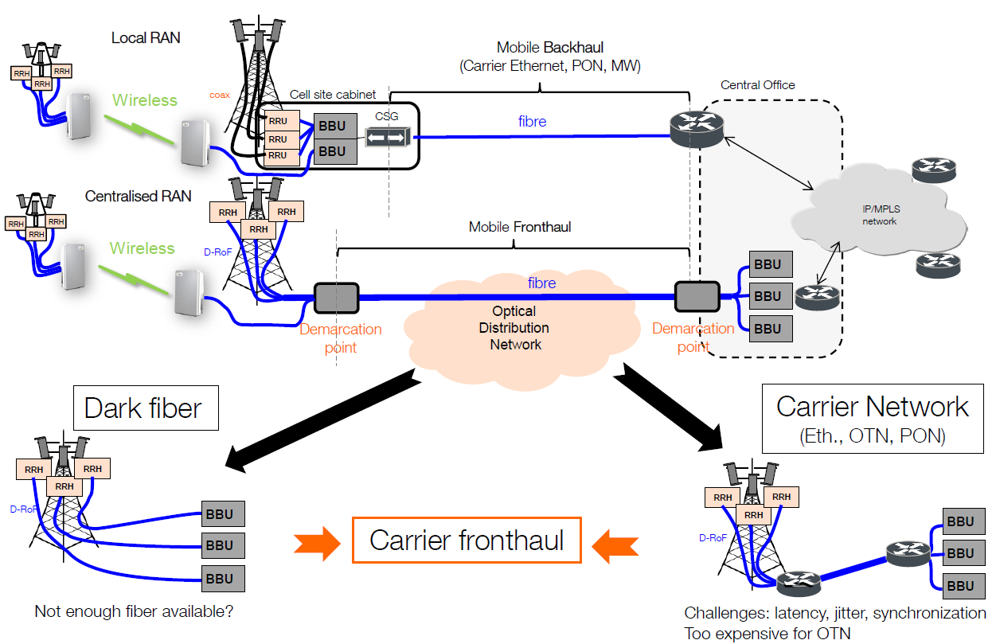
C-RAN and FrontHaul/Backhaul
Micro/Small Cell
Macro Cell
RRH: Remote Radio Head
RRU: Remote Radio Unit (same as RRH)
CO: Central Office usually within a mile
BBU: Base Band Unit
D-RoF: Digital radio over Fibber
4 Cs of C-RAN: Centralization, Cloud, Cooperation, Clean

Slide 27
Softwarization

Slide 28
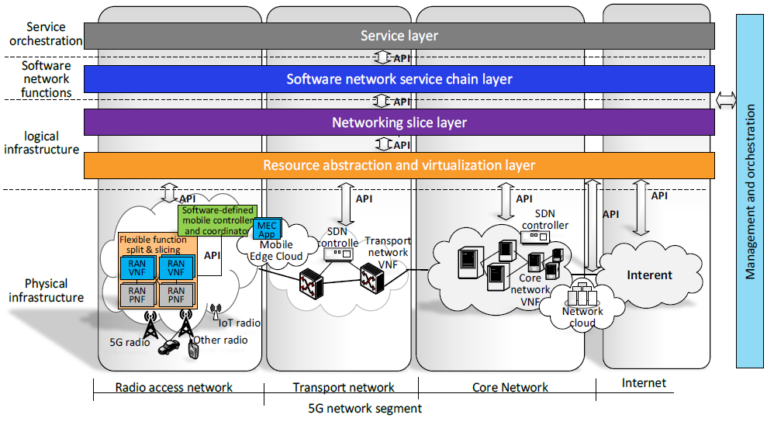
Software network technologies in 5G overall architecture
Programmability
Flexibility
Adaptability
Capabilities
“This enables developers and operators to better match needs and capabilities, building application-aware networks and network-aware applications ”
Notes:
Softwarization key enable to realize network slicing as a service
Each network segment has its own charcteristics and therefore different softwarization requirements

Slide 29
Softwarization in radio access networks and mobile network edge
RAN
Flexible Splitting and slicing of functions into PNF and VNF leveraging flexible deployment options to shift towards or away from the radio edge (depending on each slice and QoS requirements)
Synchronous functions with radio are candidate for VNF where asynchronous more for PNF, in both cases there is a need for softwarization leveraging slicing
Control plane architecture through a Software defined mobile controller allows needs a clear separation between NF being controlled and those controlling
Mobile Edge Networks
Mobile Edge Computing is a strong driver for 5G
Mobile Edge Networks will extend Softwarization from the conventional data center to the edge of the 5G network
Particularly important to achieve some of the latency objectives of 5G
Pauses string security challenges
Will be a shared control/target deployment surface between RAN/Core functions

Slide 30
Softwarization in core networks & transport networks
Core Networks
CN and Service plane functions are expected to be 100% virtualized within 5G time-frame
SDN principles will be explored for contro/data plane split and softwarization
Different Network Slices are using different VNFs deployment approaches to fulfilling differentiated QoS requirements
Transport Networks
Transport network will be entirely softwarized through NFV/SDN architecture enabling the transport network as a platform adapting to the needs of RAN/Edge/Core requirements
Very tight integration with the RAN will be required for rapid / on-demand resource provisioning/allocation/configuration

Slide 31
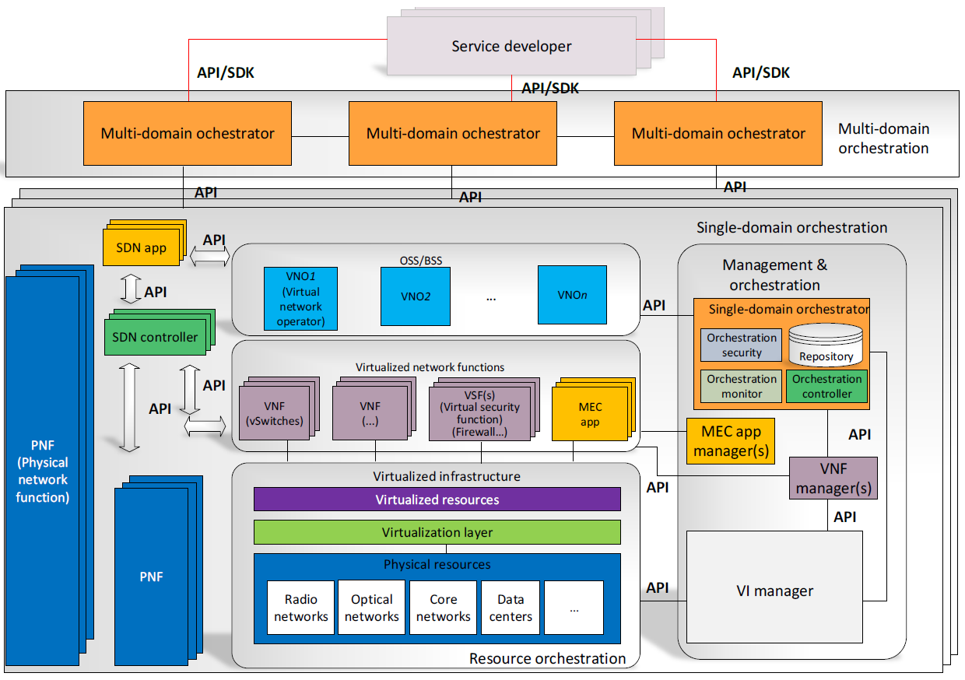
Programmability and Orchestration
With Softwarization comes the programmability enabled by APIs and associated SDKs
Softwarization implies full control of network services and functions lifecycle
Decomposition into re-usable and programmable Network Functionz which can be combined into higher level function is KEY
Resource Orchestration or Network Function Orchestration: coordination of Physical/Virtual network, Compute, storage resources to realize different services/network slices towards goals
Service Orchestration: on top of resource orchestration to provision services across multiple network segments and/or domains

Slide 32
Flexible network function orchestration
Carrier Grade Software Defined Infrastructures is looking into generalization of SDN approach to all segments/domains
Take care of the slicing and Function Chaining
Operates under set of Policies set by Infra Providers and communicate with OSS/BSS of the net service provider possibly receiving requirements from OSS/BSS
Automated management is necessary to handle the complexity in the 5G resource orchestration platform. Automated management in multi-administration environments involves defining novel business, coordination and information models, trading mechanisms and pricing schemes
Autonomic management of SDN and NFV components can be implemented in an environment that uses monitoring data collected from the various components and functions in the network, and applies machine learning (ML) techniques and algorithms to develop a model which in turn informs the network management decisions. ML techniques could address the challenge brought by accurate service demand prediction and provisioning in virtualized environments. This should allow the network to resize and provision itself to serve predicted demand according to parameters such as location, time and specific service demand from specific users or user groups. To realize these ML techniques, approaches from Big Data handling are likely to become necessary.

Slide 33
Service orchestration
Softwarization for network management indicates introducing programmability to the complete set of network management functionalities including network configuration, monitoring, maintenance, fault/failure management, security, accounting, among others. Moreover, automatization of these softwarized management functionalities will significantly reduce OPEX and CAPEX whilst offer high flexibilities, increased predictability of management quality, improved productivity and robustness
On top of this, intelligence-based, autonomic operation will need to be in place to drive the automatic deployment of the network services.
On top of this, intelligence-based, autonomic operation will need to be in place to drive the automatic deployment of the network services
The orchestration will allow instantiating end-to-end networks and services into heterogeneous technology domains and multi-vendor environments. Composite services need to take into account the seamless combination of networking with computing and storage
End-to-end service and resource orchestration will leverage northbound APIs exposed by existing networking and cloud management solutions based on SDN and NFV principles.
Network slicing will be an essential means for service provisioning, in order to accommodate different vertical sectors under a unified network infrastructure view

Slide 34
Thank you
For more details visit www.mycom-osi.com
or email info@mycom-osi.com

